Slide 1
California’s Flood Future Recommendations for Managing the State’s Flood Risk Terri Wegener, P.E., DWR Briefing for Central Valley Flood Protection Board May 10, 2013
Notes:
Picture: north_view_Yajome_from_Pearl, Napa, 2005
Overall approach to the presentation…who is here and who will present… time for questions comments after findings and again after recommendations.

Slide 2
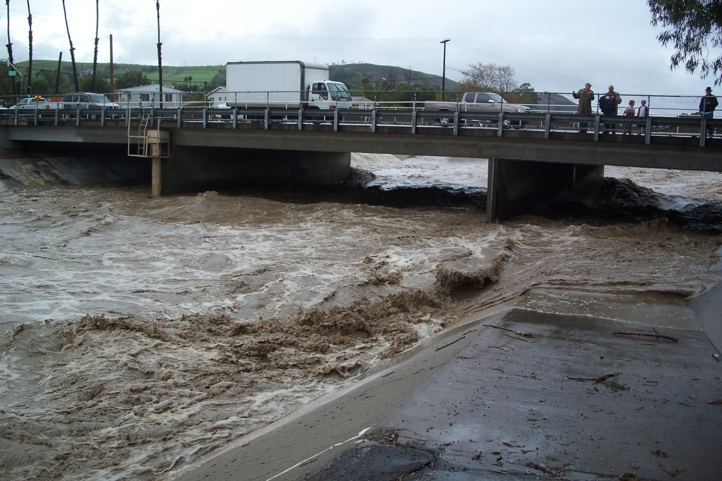
Introduction Report Purpose
Increase understanding of statewide flood problem
Make recommendations for managing flood risk
Inform decisions about:
Policies
Financial investments
Notes:
Picture: Orange County Flooding at Del Obispo December 2010
Purpose:
First report under the Statewide Flood Management Planning Program
The purpose is to develop and promote an understanding of the flood problem statewide, make recommendations for managing flood risk, and to guide decisions about policies and financial investments.
Expands other state efforts that have been focused primarily in the Central Valley.

Slide 3
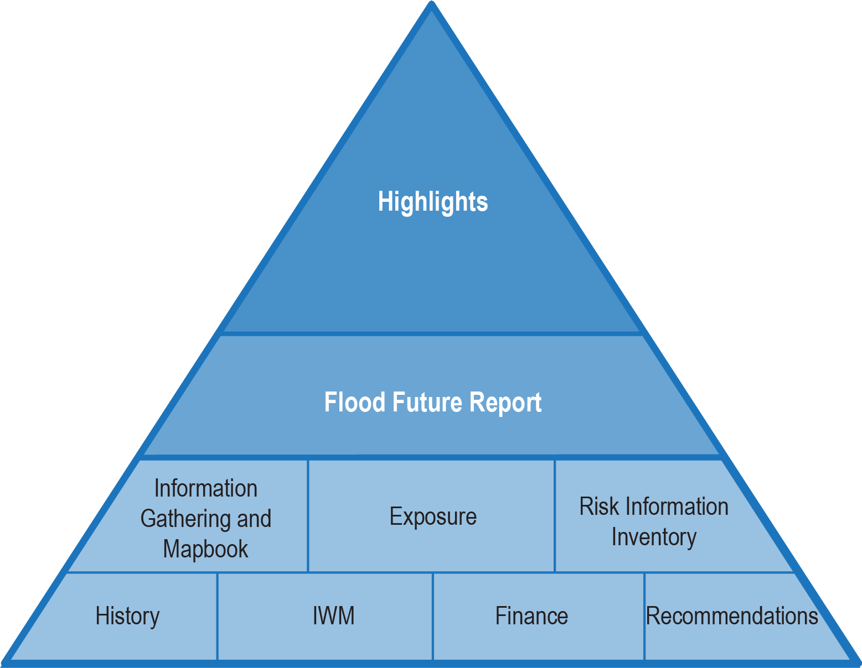
California’s Flood Future: Release Schedule
Public Drafts Released on April 3:
California Flood Future Highlights
Flood Future Report
Technical memoranda
Comments due May 20
9 regional meetings statewide
Notes:
Main Report and attachments released April 3 (8 Technical attachments)
45-day comment period with comments due May 20 – comment form available on website
Holding 9 Statewide regional meetings

Slide 4
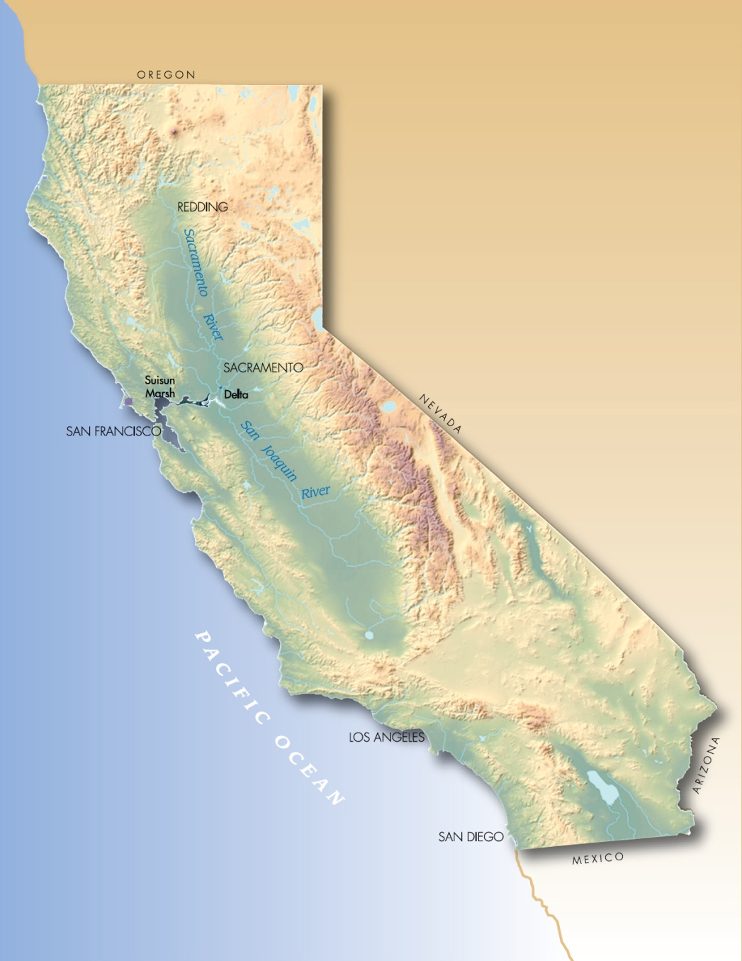
Introduction DWR Flood Planning
Central Valley
CVFPP
Statewide
Flood Future Report
California Water Plan
CVFPP Study Area
SFMP Study Area
Notes:
Notes:
Other ongoing studies that are an outgrowth of the CVFPP: CVIFMS-(how federal interests can be aligned in the CVFPP future projects), CVFPP regional planning

Slide 5
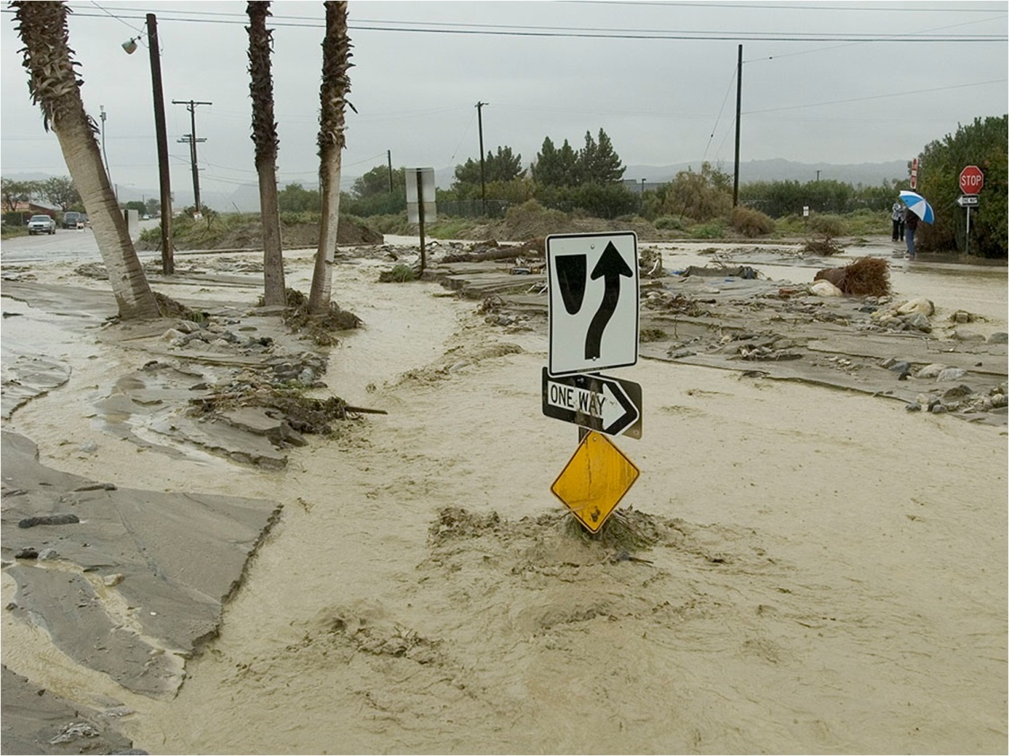
California is at risk for catastrophic flooding!
Devastating impacts to California and the nation
1 in 5 Californians are exposed to flooding
$580B in assets are exposed to flooding
Every county has experienced a Federally declared flood disaster in the last 20 years
Notes:
Picture: Thousand Palms, 2005
Key Facts:
California is at risk for catastrophic flooding.
We have found that 1 in 5 Californians are living in a 500-year floodplain.
And flooding is not limited to one region – each county has been declared a federal disaster area at least once for flooding in the past 20 years.
Flood insurance policies have tripled since 1982.

Slide 6
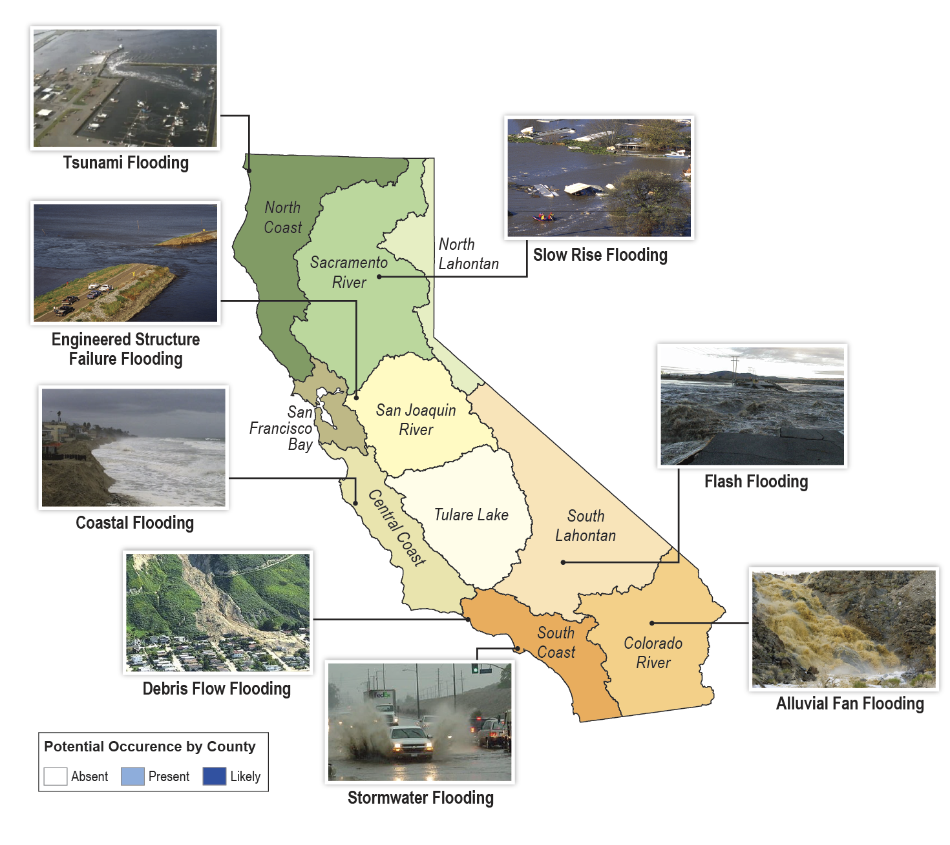
California experiences many types of flooding
Notes:
One of the problems is that there are so many kinds of floods in CA – all with different characteristics, warning times, etc. From tsunami and coastal to slow rise, to debris flow and alluvial fan flooding, to failure of engineered structures such as dams and levees…
Warning time
Land forms
Climate
Precipitation times
Duration
Area flooded
Causes

Slide 7
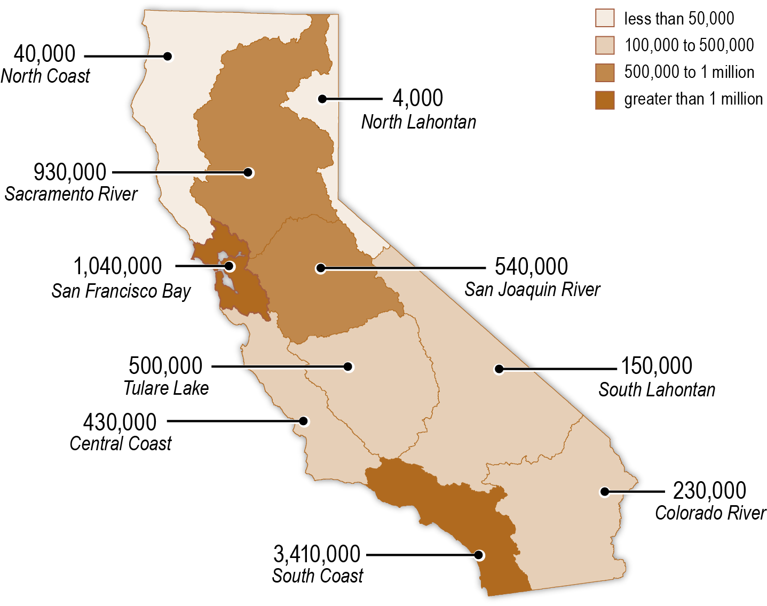
7.3 million Californians live in floodplains
Number of People in Floodplain
Statewide Total = 7.3 million
Notes:
Over 7 million Californian’s live in 500-year floodplains
1.4 million in 100-year floodplain
Regions with highest population exposed:
SOUTH COAST -3 million
SAN FRANCISCO – 1 million
SACRAMENTO – 1 million
SAN JOAQUIN – ½ million
TULARE – ½ million
CENTRAL COAST – ½ million

Slide 8
7.3 million Californians live in floodplains
Number of People in Floodplain
1.5
1.0
0.5
0.0
Statewide Total = 7.3 million
Exposed Population (Millions)
Santa Clara
Orange
Los Angeles
Notes:
San Diego, Orange, and Los Angeles counties have largest population at risk
Bar chart pop up minus state average
BAR GRAPH (% POP in floodplain VS COUNTY NAME)
Sutter 94%
Yuba – 69%
San Joaquin – 66%

Slide 9
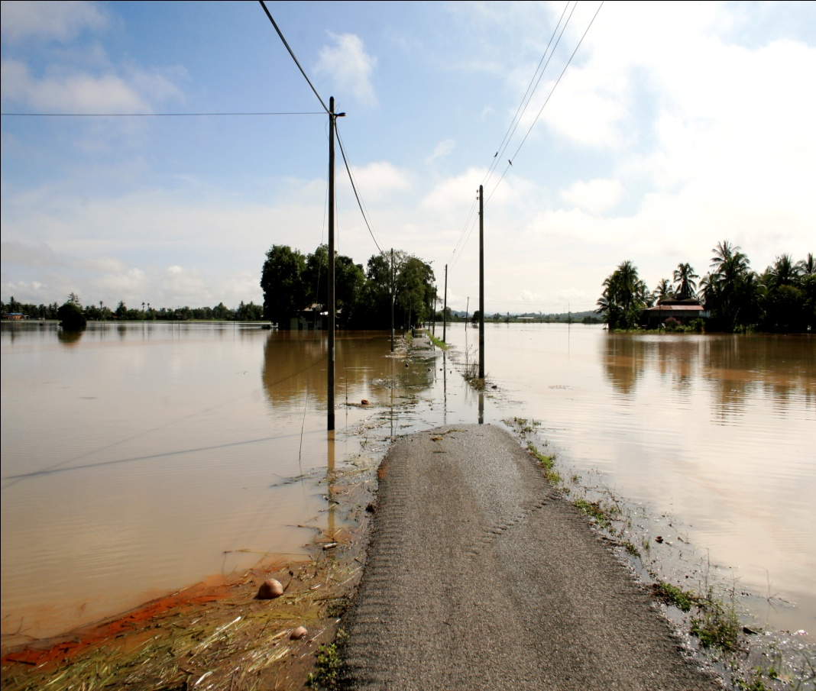
7.3 million Californians live in floodplains
Number of People in Floodplain
100
75
50
25
0
Statewide Total = 7.3 million
Exposed Population (Percent)
Sutter
Yuba
San Joaquin
Notes:
Sutter 94%
Yuba – 69%
San Joaquin – 66%
Monterey over 50%
Tulare over 50%

Slide 10
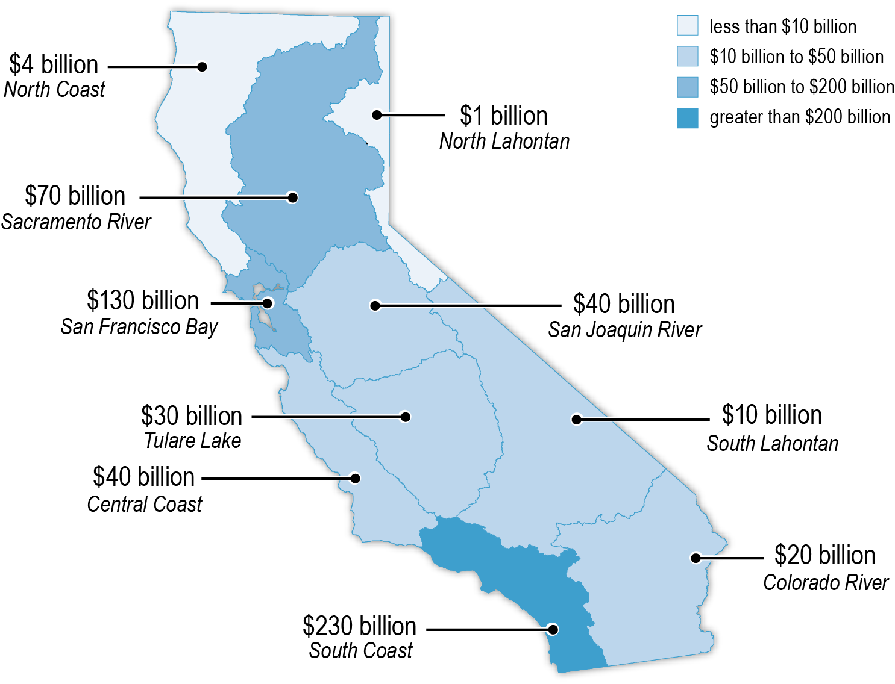
$575 billion in structures are at risk
Number of Structures in Floodplain
Statewide Total = $575 billion
Notes:
STRUCTURES/REPLACEMENT CONTENT VALUE: defined as residential, commercial, industrial, and public infrastructure
Regions with most structures exposed:
SOUTH COAST -230 billion
SAN FRANCISCO -130 billion
SACRAMENTO - 70 billion
SAN JOAQUIN/ CENTRAL COAST -40 billion

Slide 11
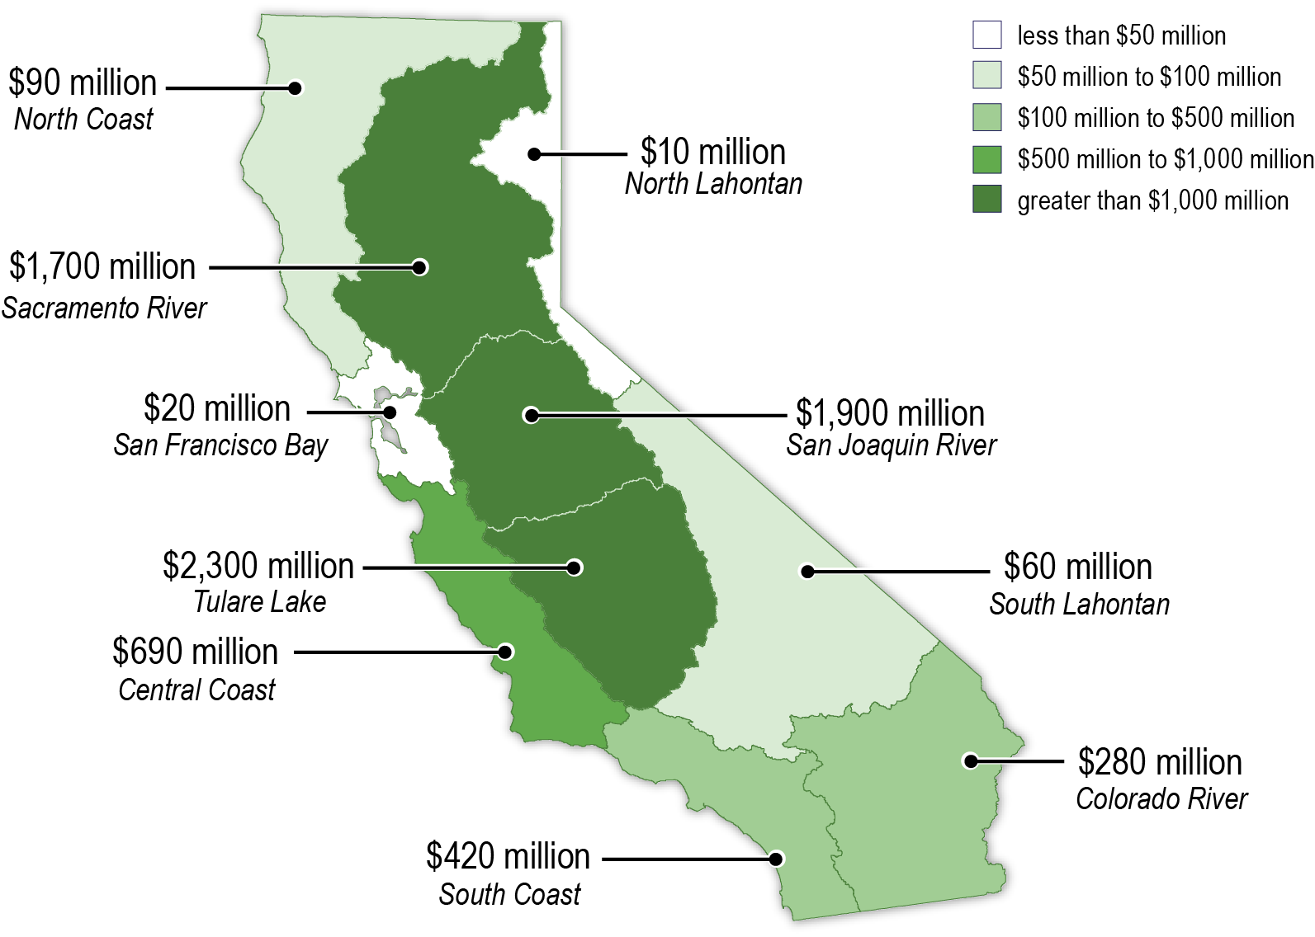
California’s agricultural economy is at risk
Crop Value in Floodplain
Crop Value in Floodplain
Statewide Total = $7.5 billion
Statewide Total = $7.5 billion
Notes:
7.4 BILLION in crop value statewide in 500 year floodplain
40 percent of agricultural land in state is in a floodplain
Agriculture one of top economic exports –
50% of US produce and nuts
Regions with most crops exposed:
TULARE - 2.3 billion
SAN JOAQUIN – 1.9 billion
SACRAMENTO – 1.7 billion

Slide 12
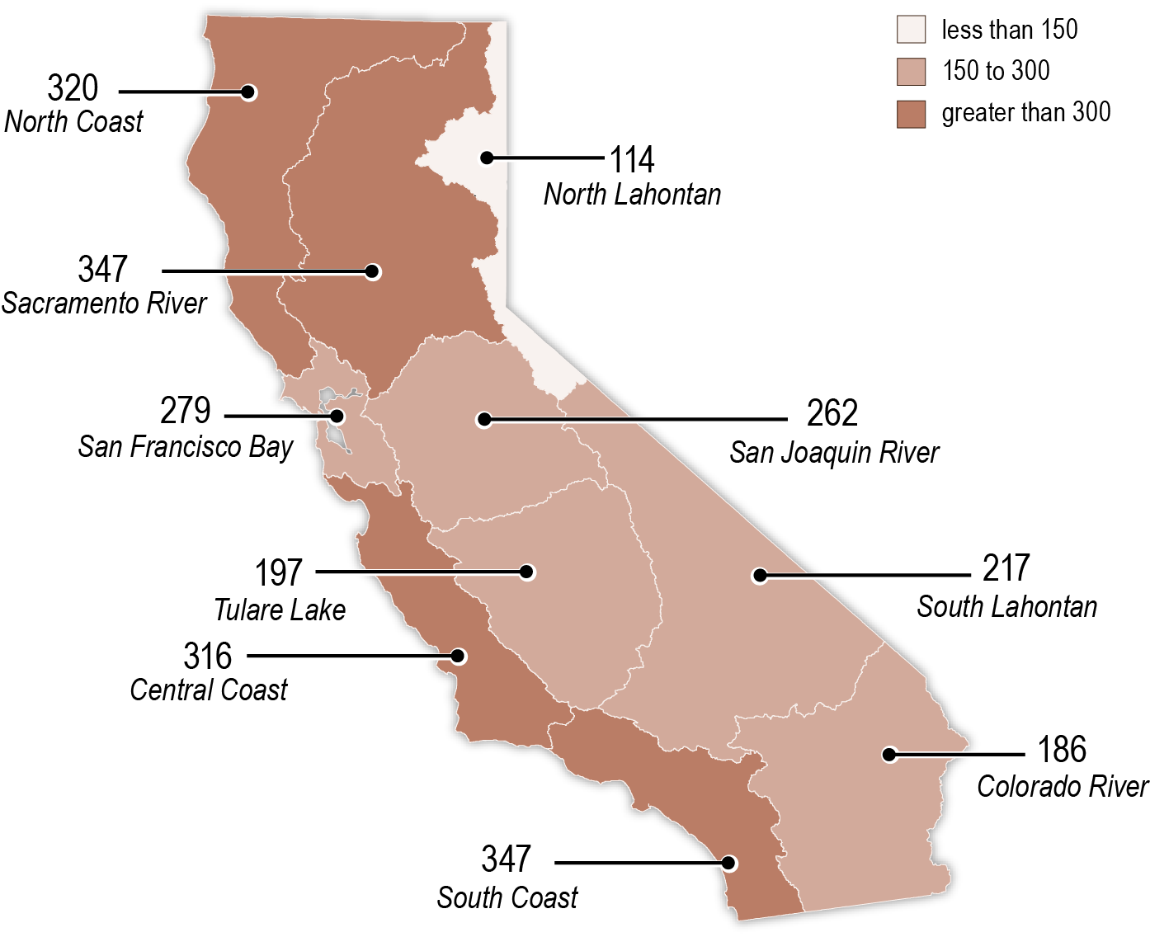
Floodplains are rich in environmental resources
Number of Species in Floodplain
Notes:
Sensitive Species
Sensitive Species include: State and Federal Threatened, Endangered, Listed, and Rare Plants and Animal Species
-- Environmental Stewardship suffers from competing regulations and processes.
-- Floodplain function difficult to maintain due to antiquated processes and conflicting resource agency standards
-- Effective floodplain management finds the appropriate balance between providing for public safety while reducing risk to sensitive ecosystems.
-- Sensitive species are exposed to flood hazards throughout the state.
-- Sensitive-species habitat is commonly located in floodplains.
-- Floods deliver environmental destruction and environmental benefits
-- Floodplains provide a variety benefits POSITIVE (1) attenuates flows, provides for habitat, recharges GW basins, improves WQ, and controls erosion and (2) provides habitat and for beneficial connections between habitats; NEGATIVE (1) deposits debris, contaminants, and decay and (2) destroys or inundates habitat and species

Slide 13
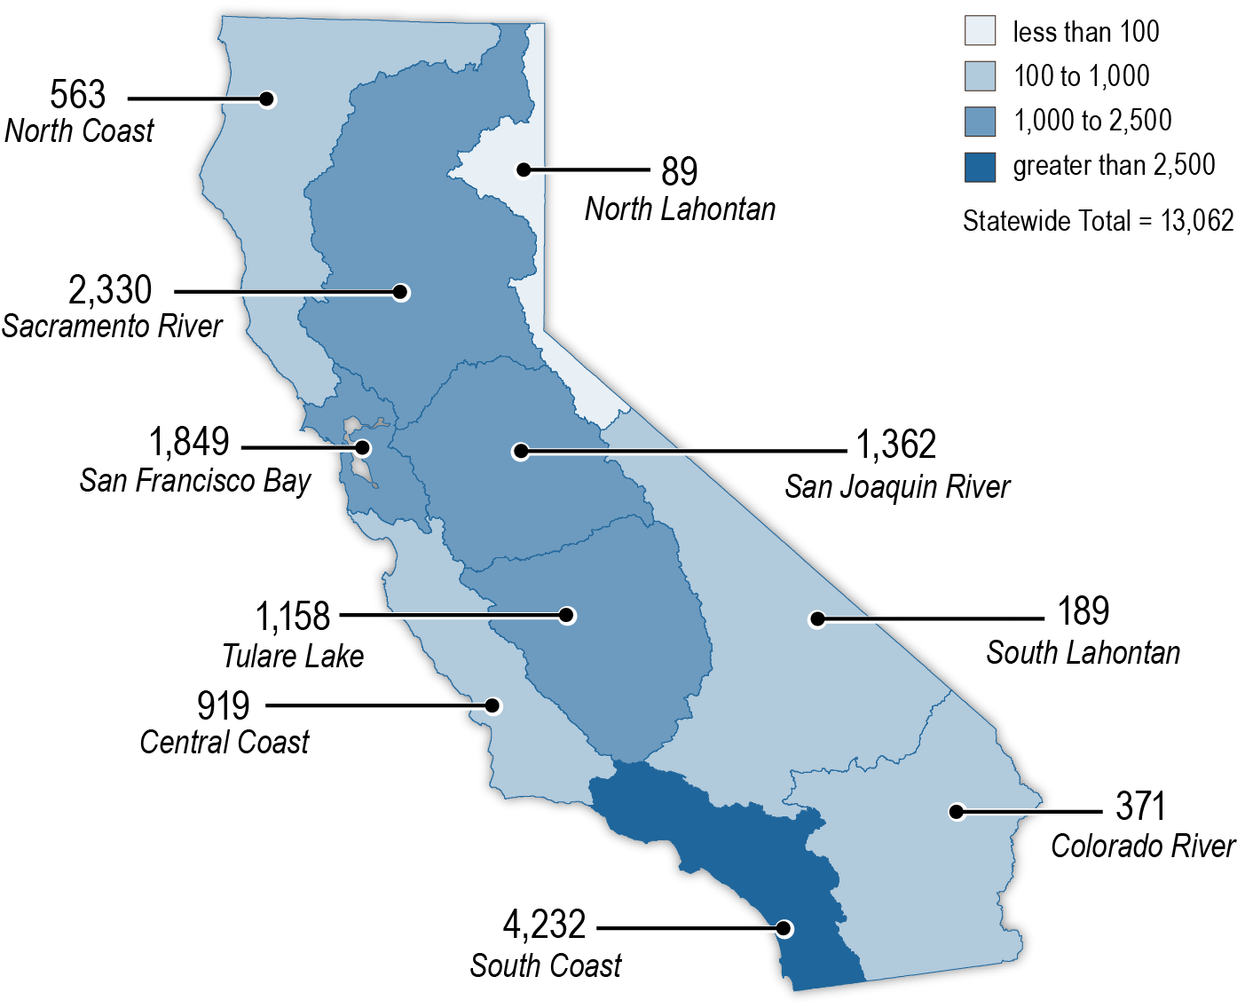
Critical facilities are at risk
Number of Critical Facilities in Floodplain
Notes:
Critical Facilities
-Critical facilities are important: just because don’t live in a floodplain you life can be affected– school, water treatment plant, movie theatres, etc.
-13K FACILITIES throughout state in 500-year floodplain
-Critical facilities include:
schools
fire/police stations
hospitals
utilities
transportation
high potential loss
Regions with most facilities exposed:
SOUTH COAST – 4K
SAN FRANCISCO – 2k
SACRAMENTO – 2K
SAN JOAQUIN – 1,300

Slide 14
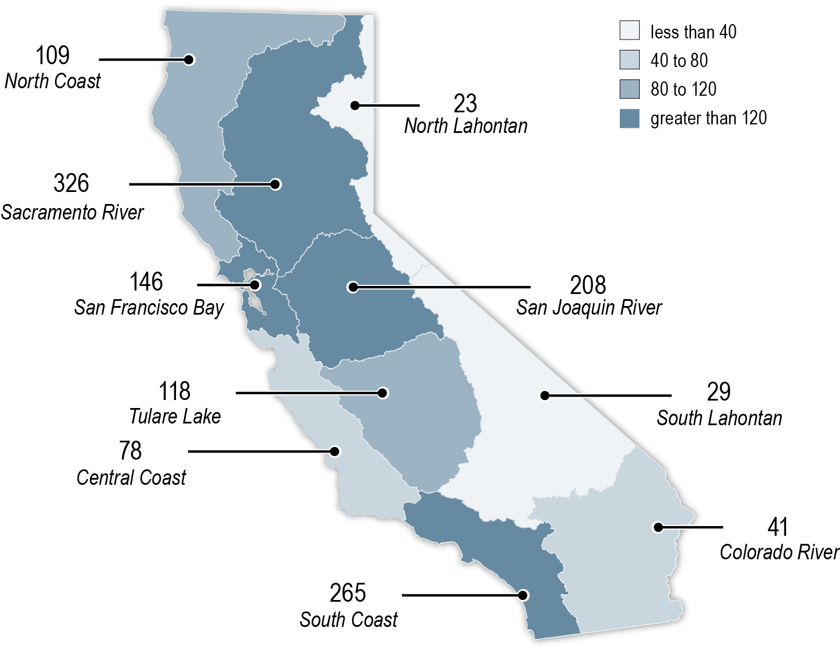
Flood management authority is complex and fragmented
Number of Agencies
Statewide Total = 1,343
Notes:
Management is complex and agencies have differing responsibilities, priories, and funding
Over 1,300 agencies with Flood management responsibilities
Overlapping (conflicting) responsibilities and priorities
Complex maze of new or conflicting regulations

Slide 15
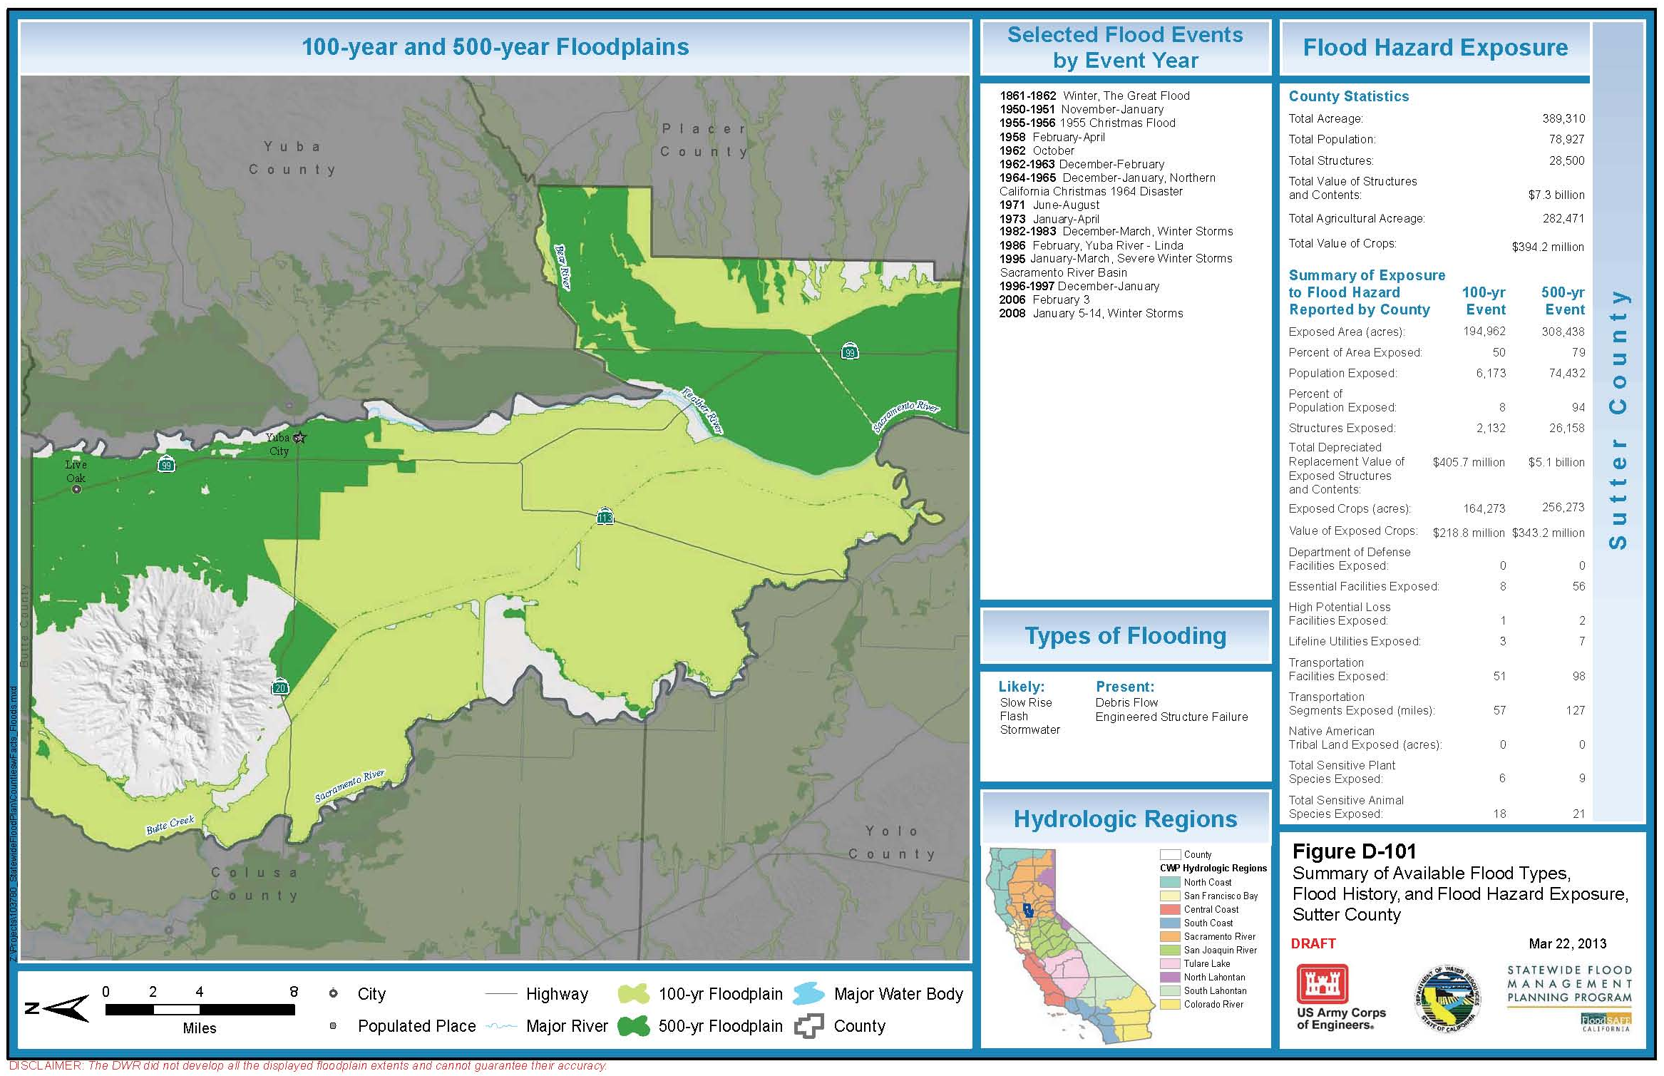
County mapbook example
Notes:
Sample page: Butte County
Mapbook example page:
Shows flood events
Exposure
Types of flooding
Infrastructure available electronically

Slide 16
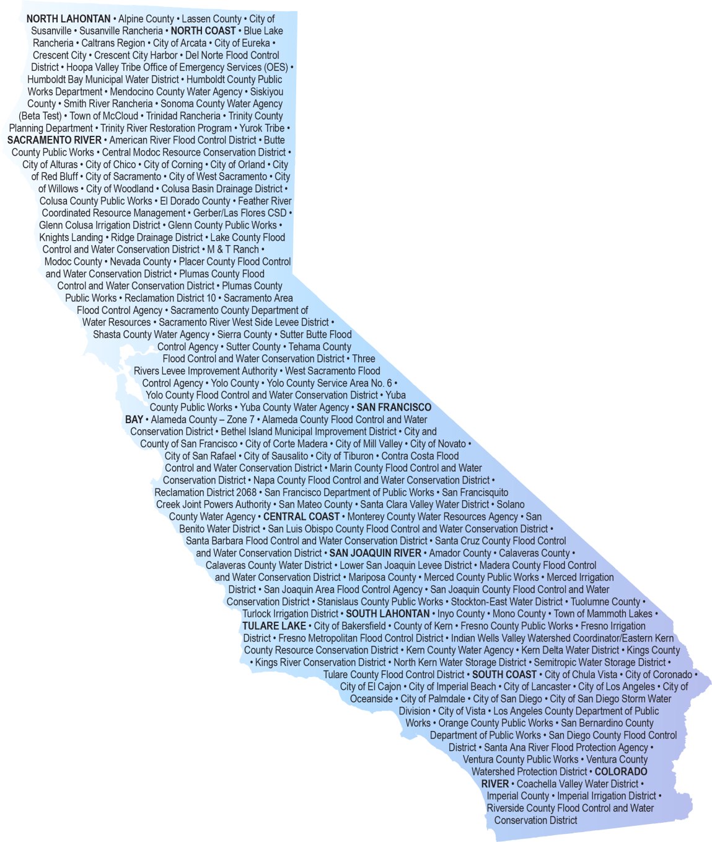
Local agencies speak out
Inadequate data
Limited understanding by Public and Policymakers
Emergency management coordination
Inconsistent land use planning
Fragmented responsibility
Conflicting permit requirements
Unstable funding
Notes:
Over 100 different recommendations summarized under 8 categories:
Different risk methodologies and inadequate data
Public understanding of risk is inadequate
Limited emergency management funding
Land use decisions may not protect public safety
Projects are not prioritized
Flood management responsibility is fragmented
Permitting is a complex obstacle balancing public safety and environmental needs
Sufficient and stable funding is needed

Slide 17
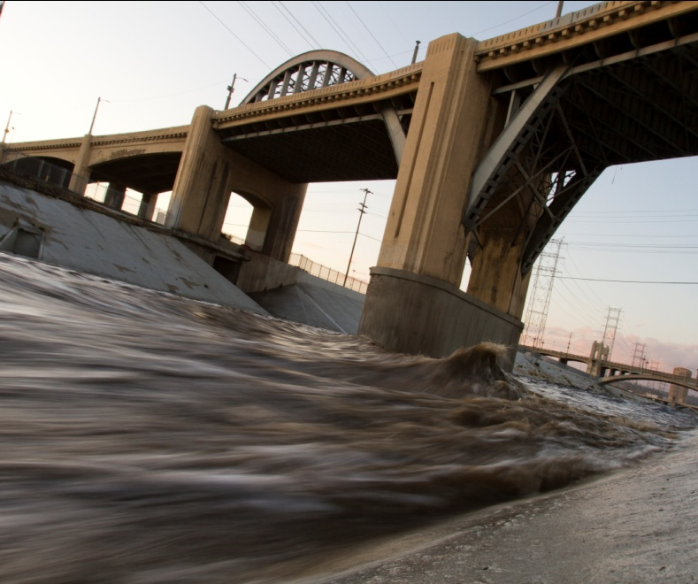
Flood infrastructure does not meet current and future needs
800+ projects identified statewide
$30-$50+ billion in improvements and projects
Will not provide a 100-year level of protection statewide

Slide 18
Flood funding is limited and unreliable
Inconsistent and insufficient funding
Declining local resources
Reduced Federal cost shares
Challenging revenue structure
Cost of flood management misunderstood by public and policy makers
Notes:
Funding for flood management are lower than those for water supply and wastewater
Funding is limited and increasingly unreliable
Financing challenges include:
Inconsistent and Insufficient Funding
Declining Local Resources
Reduced Federal Cost Shares
Challenging Revenue Structure (prop 218 and 13, bond funding, assessment areas)
Cost of flood management misunderstood by public and policy makers

Slide 19
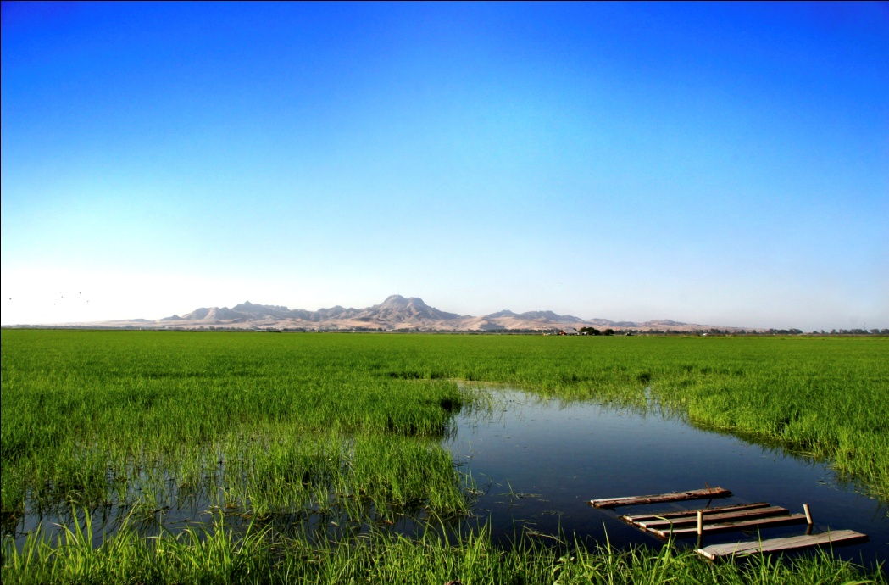
Solutions must use an Integrated Water Management Approach
Combines flood management, water supply, and ecosystem actions
Regional and systemwide approach
Collaboration and cooperation
Array of funding sources

Slide 20
Recommendation
Conduct regional flood risk assessments to better understand statewide flood risk.
TOOLS
Notes:
Many understandings of flood risk and residual risk
Identifying flood risk is an important first step toward reducing risk and prioritizing projects. Few detailed studies have been completed. Thus leads to oversimplification of flood risk or leaving risk undetermined.
Goal: Consistent and locally appropriate methods for assessing flood risk to help local governments make informed decisions; Prioritize flood management projects throughout the state.
Information about climate change and sea level risk has not been developed for all areas of the state and access to current information is not uniformly available.
Identify regional methods for risk assessment
Evaluate flood risk in each region
Set Risk reduction goals
Identify opportunities to restore and maintain natural systems
Climate change and sea level rise

Slide 21
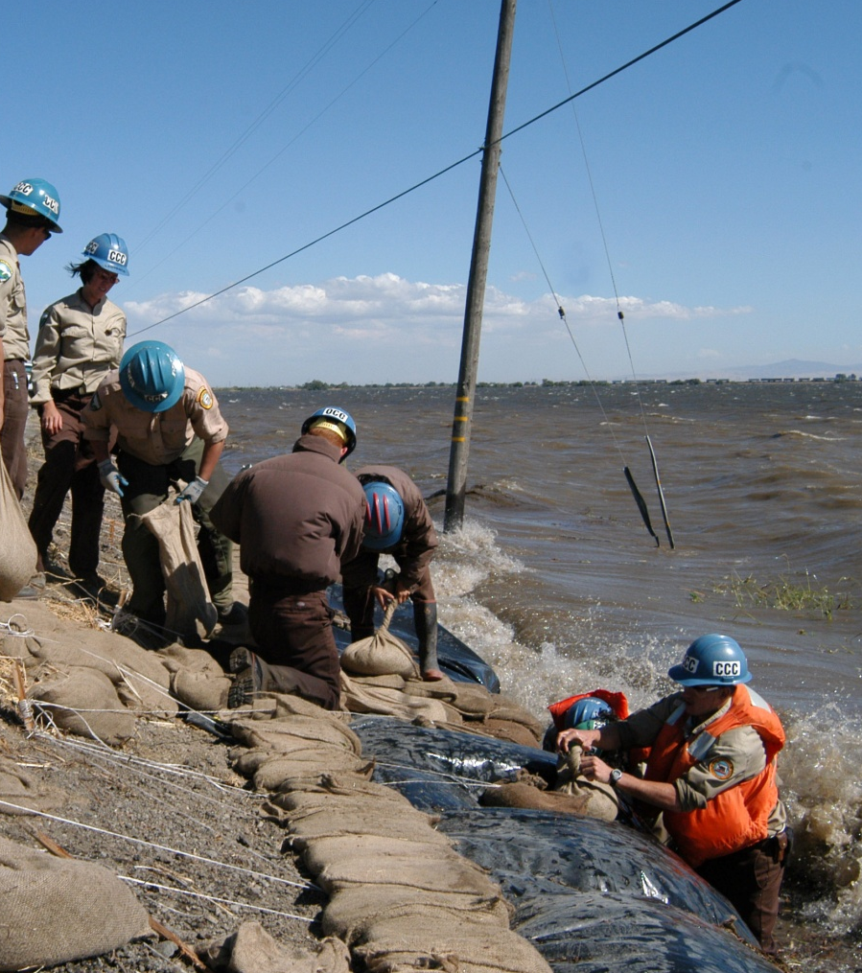
Recommendations
Increase public and policymaker awareness about flood risks to facilitate informed decisions.
Increase support for flood emergency preparedness, response, and recovery programs to reduce flood impacts.
TOOLS
Notes:
REC 2: Residents and policymakers have varying levels of understanding about the risk and consequences of flooding. As a result, decisions could be made about land use and during emergencies that lead to putting people and property at increased risk.
Goal: officials place higher priority on flood management; Citizens understand risk and know what actions to take to reduce personal risk before during and after a flood
Common language will help avoid public confusion – working together to develop awareness initiatives will maximize limited financial resources
Share resources, materials, tools, templates, etc. among agencies; Expand existing awareness initiatives
Provide online – easy access to information, data, case studies, budget information, planning tools etc.
Share research findings in a timely fashion
Tools: Consistent messaging
Online tools
Share data and information
REC 3: Flood emergency management is a cost-effective tool to reduce flood loss. Flood emergency preparedness, response, and recovery programs are often fragmented between local agencies within a region or even with different departments of a single agency. Funds for emergency planning are often the first cut during difficult budgeting times.
Goal: Effective and efficient flood emergency management preparedness, response, recovery throughout state
Provide support for coordination among appropriate agencies.
Shrinking budgets, first hit due to General Fund.
Tools: Funding for coordination for flood readiness
Flood Emergency Management Plans
Flood Fight Training
Data and forecasting Needs

Slide 22
Recommendations
Encourage land-use planning practices that reduce the consequences of flooding.
Conduct flood management from regional, systemwide, and statewide perspectives to provide multiple benefits.
PLANS
Notes:
REC 4: Local Decisions, but collaborating with state, federal and local agencies collaborating so locals can make informed decisions
Goal: Reduced risk to people, property, and economies in floodplains
Strategy: Land Use Planning Principles to reduce flood risk
Coordination between planners and emergency managers
Incentivize best management practices
REC 5:
Goal: Agencies at all levels use and IWM approach for flood management
Strategy: regional flood planning areas
Prioritize flood management projects
Improve state and federal processes
Improve coordination
Incentivize an IWM approach

Slide 23
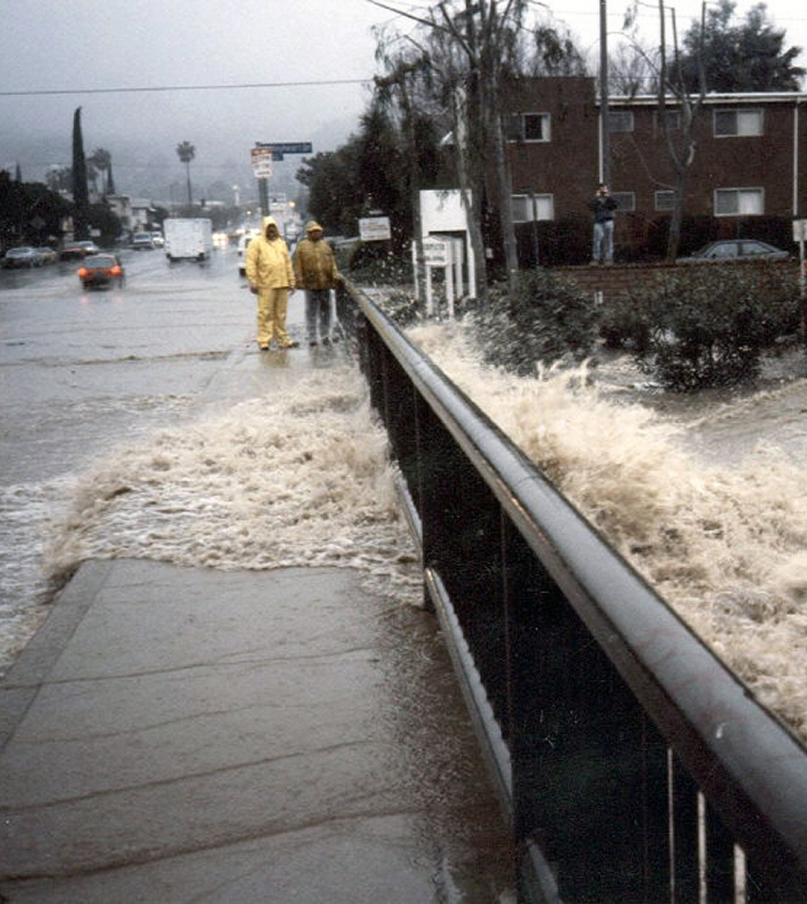
Recommendations
Increase collaboration among public agencies to improve flood management planning, policies, and investments.
Establish sufficient and stable funding mechanisms to reduce flood risk.
PLANS
Notes:
REC 6: California has over 1300 agencies that have flood management responsibilities This complex governance situation makes agency coordination fragmented and difficult. Increasing agency alignment will help resolve permitting, planning, and funding.
Goal: Efficiency in all aspects of government related to flood management
Establish regional working groups to address permitting, planning and implementation – work together to solve regional issues
Realign funding programs to encourage local agencies to collaborate with each other on multiple benefit projects
Develop a methodology to prioritize flood management investments – to be used by all level of governments to set investment priorities across the state.
REC 7: Prioritize and communicating flood management investment needs will help generate support for increased funding.
Sufficient and stable investment in ca flood management systems can help avoid much larger future costs for flood recovery.
Goal: sufficient and stable funding
Work together to propose changes or alterations to local funding methods.
Develop a central online database resource that describes the different funding programs and provides guidance on how to access that funding.
Work together to advocate for sufficient and stable funding sources for regionally-based integrated water management projects.

Slide 24
We Must Take Action. Now.
California’s future depends on:
Local, State, Federal, and tribal agencies working together
Implement policies and projects using an IWM approach
Increase awareness of the cost and consequences of flooding
Establish investment priorities and sufficient and stable funding
Short-term and long-term action and solutions

Slide 25
SFMP Website
For More Information about California’s Flood Future :
http://www.water.ca.gov/SFMP

Slide 26
California’s Flood Future Report Recommendations for Managing the States Flood Risk August 2012
For more information:
Terri Wegener: terri.wegener@water.ca.gov
Jason Sidley: jason.sidley@water.ca.gov
http://www.water.ca.gov/SFMP
Notes:
Pic: Sutter Butte

